Slide 1
Complete College Idaho Plan
State Board of Education Meeting
June 21, 2012

Slide 2
CCI Plan
Notes:
Mikes introduction with context

Slide 3
Complete College Idaho
Complete College Idaho
Strengthen the Pipeline
Transform Remediation
Structure for Success
Reward Progress & Completion
Leverage Partnerships
Talent (Skilled Workforce)
Economy (Project60)
Innovation (IGEM)
Notes:
Review CCI strategies and changes to the plan (Leverage Partnerships replaces Demystify College)

Slide 4
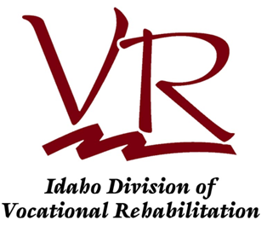
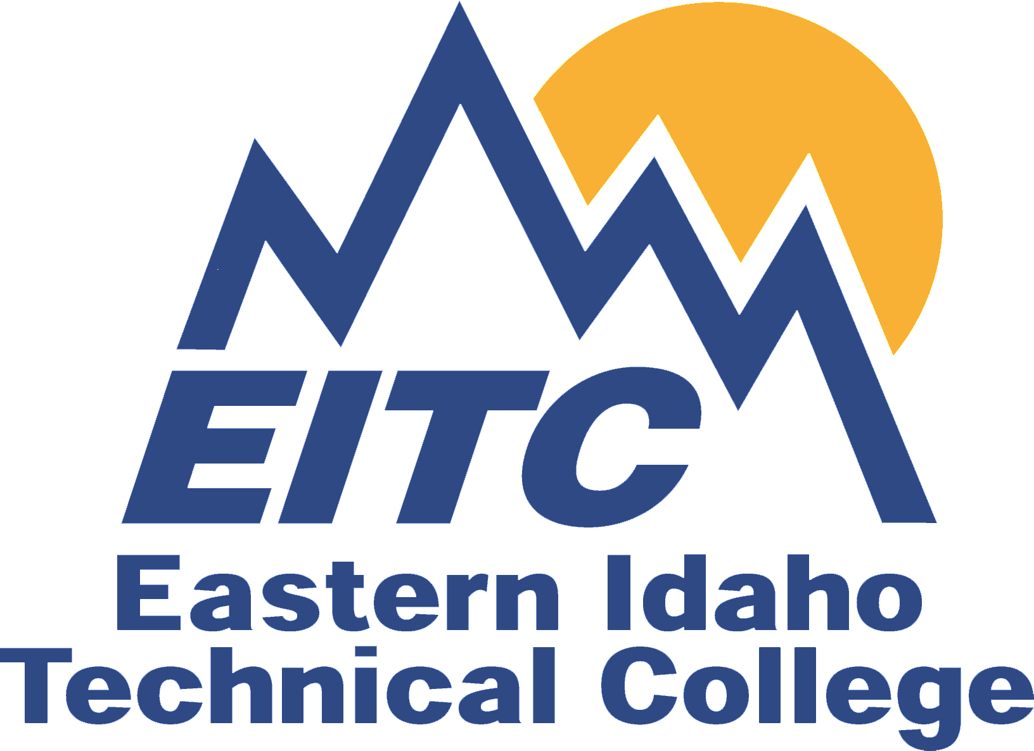
Strategies
Statewide Initiatives
vs.
Institution/Agency Initiatives
Notes:
In conjunction with each key strategy listed above are a number of initiatives that may be implemented at either the state level or the institution/agency level.
For example, adopting the Common Core State Standards is a way the state is supporting the strategy “Strengthen the Pipeline.” An institution and local education agency may support that strategy using collaboration to prepare students for college and career through the development of a college mentoring program employing recent college graduates.

Slide 5
Strengthen the pipeline
Notes:
Students should be college-ready when they graduate high school; doing so requires that high school curriculum is aligned to first year college courses and that support programs are in place to ensure students make a smooth transition to college.

Slide 6
Strengthen the Pipeline
Ensure College and Career Readiness
Notes:
Increase rigor in secondary school courses to prepare students for postsecondary coursework (Common Core State Standards)
Incorporate mandatory college readiness assessments in middle school and junior year of high school
Leverage work of the Common Core State Standards to develop and articulate high school to postsecondary standards in English and mathematics – organize faculty to faculty efforts
Work towards recognition of the Smarter Balance Assessment outcomes for students as indicators of threshold for college and career readiness

Slide 7
Strengthen the Pipeline
Develop Intentional Advising Along the K-20 Continuum
Notes:
Integrate Collaborative Counselor Training Initiative into pre-service school counselor and teacher requirements (teachers as advisors)
Improve direct adult contact with students vis-à-vis counselors (Near Peer Mentoring Program)

Slide 8
Strengthen the Pipeline
Support Accelerated High School to Postsecondary and Career Pathways
Notes:
Increase and improve management and delivery of Tech Prep and Dual Credit programs
Evaluate current Tech Prep and Dual Credit policies and practices
Revise Tech Prep and Dual Credit policies and practices based on the results of the evaluation
Provide more 2+2 opportunities

Slide 9
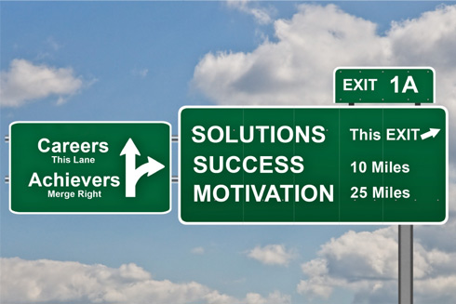
Transform Remediation
Notes:
In Idaho, 41% of all first-time full-time freshman who have been out of high school for less than 12 months were identified as needing remedial services.
Remedial need is not only a problem for recent high school graduates. 46% of Idaho students out of high school for greater than a year were identified as needing remedial support.
However, remediation in its current form is ineffective. Most students who require remedial education do not complete their remedial education sequence within a year. Many do not even enroll in remedial education.

Slide 10
Transform Remediation
College and Career Readiness Education and Assessments

Slide 11
Transform Remediation
Statewide Model for Transformation of Remedial Placement and Support
Notes:
Complete Institutional Readiness Inventory Evaluation
Evaluate efficacy of current student placement and success
Determine appropriate mechanisms to assess student readiness for college-level work
Articulate content area competencies and student learning outcomes

Slide 12
Transform Remediation
Co-requisite model, Emporium model, or Accelerated model
Notes:
Remediation group working on reform. Revise policies regarding placement, delivery, and evaluation of remedial services.

Slide 13
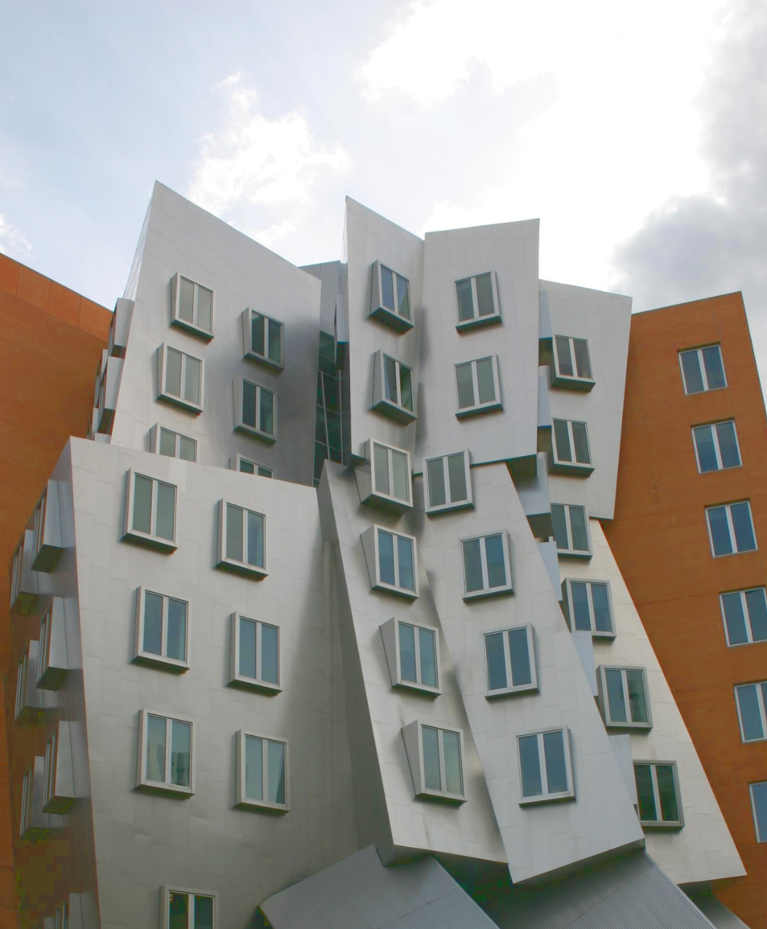
Structure for success

Slide 14
Structure for Success
Communicate Strong, Clear, and Guaranteed Statewide Articulation and Transfer Options
Notes:
Create a state-level student success web portal with clearly articulated pathways to certificates/degrees
Create a course equivalency guide focused on multi-institution transfer and articulation
Improve transferability and integration of Professional-Technical Education (PTE) courses into advanced degree requirements
Establish appropriate policies and procedures that allow for reverse transfer options to students who transferred from a 2-year institution to a 4-year institution prior to earning an associate’s degree
Reform general education core (LEAP framework) to include revised policies and practice

Slide 15
Reward Progress and Completion

Slide 16
Reward Progress & Completion
Establish Metrics and Accountability
Notes:
Staff and institutions select three to five CCA common college metrics for use as system-wide metrics
Institutions select three to four indicators or measures from their NWCCU Year One Self-Evaluation Report Core Themes to be used as their institution-specific performance metrics
Board adopts system-wide and institution-specific metrics for FY 2013
Use FY 2013 as a transitional year for purposes of deploying and assessing the metrics

Slide 17
Reward Progress & Completion
Recognize & Reward Performance
Notes:
Create and adopt methodology for allocating performance funding
Submit budget request for performance pool if applicable

Slide 18
Reward Progress & Completion
Redesign Current Offerings of Financial Support
Notes:
Redesign statewide scholarships to enhance student access and completion

Slide 19
Leverage Partnerships
Notes:
This is a new initiative. Based on feedback received from stakeholders, we recognized that an initiative focused on partnerships between education and business and industry was lacking

Slide 20
Leverage Partnerships
Strengthen Collaborations Between Education and Business/Industry Partners
Notes:
Collaboration between education with the business community, non-profit and philanthropic organizations to project and meet workforce requirements and business development opportunities

Slide 21
Leverage Partnerships
College Access Network
Notes:
College Access Network – we spoke briefly about the College Access Network and the assistance IBCEE has provided in vetting the plan in tandem with collecting information to create a statewide network
The development of a College Access Network is an initiative aimed at creating a college-going culture. Linking agencies, organizations, and businesses to coordinate a network is an essential strategy to building a statewide communication plan, the purpose of which is to provide common information to all Idahoans about the benefits of postsecondary education. Additionally, it will serve as a conduit for communication between entities regarding higher education and access programs.

Slide 22
Leverage Partnerships
STEM Initiatives
Notes:
STEM Education - Develop a statewide strategic plan for K-20 STEM education in Idaho

Slide 23
60% Goal
Refining the
Goal-related Findings
WICHE States
Staff Recommendation
Notes:
The SBOE’s goal is that 60% of Idaho’s 25 to 34 year olds will have at least a 1-year postsecondary credential by 2020. December was the last time that we collectively discussed the data and the analysis behind the goal. Much of the analysis has been refined and expanded since that time. Today, I’ll be sharing these updates with you.
Brief review of 60% Goal
Describe the refinement of the analytical methods
Share goal related findings
Idaho comparison to WICHE states
Staff recommendation & reasoning behind it
Jessica & Selena will talk about the Complete College Idaho Plan and where we are going from here

Slide 24
Refining the 60% Goal
Associate’s Degree or Higher
Notes:
The latest data available from the 2010 ACS says that Idaho is at 31.2% of its 25 to 34 year olds with an Associate’s degree or higher.
Describe graph axes…% of Idahoans with an Associate’s degree or higher…
Measure doesn’t include certificates, which are not captured separately by the ACS. We estimate that 1-year & greater certificates add about 4% to 5% to this rate putting Idaho at about 35% towards its 60% Goal.
The data source here was the Census Bureau’s American Community Survey via the NCHEMS website. The ACS is a sample of Idaho households. The survey’s results have a 90% margin of error of about +/- 1.7 to 1.9%.
2005, 30.0%
2006, 30.8%
2007, 33.4%
2008, 34.1%
2009, 31.4%
2010, 31.2 %
One disturbing recent development AND potential future barrier to tracking this information is that the U.S. House of Representatives has voted to eliminate the CB’s American Community Survey. The Senate has yet to vote on the issue. If this survey goes away, Idaho will not have a method in place to track this measure. Conducting our own survey to match the accuracy of the ACS is estimated to cost more than $130,000 per survey. High cost due to getting accurate phone #’s or mailing addresses on 4,100 25-34 year olds.

Slide 25
Refining the 60% Goal
Reconcile data
Apply reconciliation factors
Validate assumptions
Vetting results
Notes:
Recall that ACS = Census Bureau’s American Community Survey
GRC = Goal Related Credentials…1-year or greater certificates, Associate’s, & Bachelor’s degrees.
Reconcile historical degree production with subsequent Census Bureau population education attainment levels.
Apply those historical reconciliation factors to recent & future GRC production to get GRC projections.
Validate assumptions including:
Population estimates,
In- and out-migration rates, and
Age at graduation.
Assumptions: 2020 Idaho 25-34 population @ 220,600.
Factors: In migration of credentials, Idahoans earning credentials from institutions not reporting to IPEDS (51.4%);
out migration public (23%), BYU-I (50%), Other Private (5%); and
graduates older than 35 (20%).
Validation: Used IDOT Driver’s License surrender data; 2005-2007 CB ACS/NCHEMS state-level ed. level migration data.
Vetted with Board Office staff & IR’s. Dr. Rush also shared some of this information with the President’s Council.

Slide 26
Goal-Related Findings
Notes:
I’ve (We’ve) been able to quantify & estimate a few critical factors that affect the accumulation of GRC in the state.
I’ve had numerous conversations with many of you about these factors, but didn’t necessarily have data that described the magnitude of some of these considerations. However, now I do to at least some extent.

Slide 27
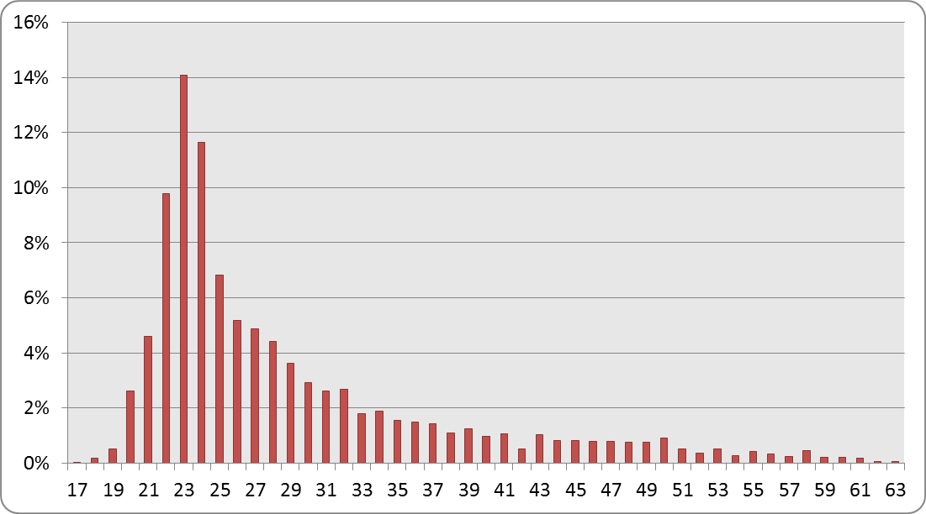
Goal-Related Findings
Age at Graduation
43%
37%
20%
Notes:
Describe graph axes…% of age category on vertical & age at graduation on horizontal.
These are the frequencies of graduate ages at the time of graduation.
Approx. 20% of Idaho’s public postsecondary graduates are 35 years old or older.
43% are < 25 years old.
37% are 25 to 34 year olds.

Slide 28
Goal-Related Findings
51%
In-Migration
Notes:
Based on limited Driver’s Licenses surrendered & CB state-to-state migration data, approx. 51% of the GRC for Idaho’s 25-34 year old population come from in-migration AND/OR attainment of GRCs from institutions that don’t report postsecondary data to U.S. DOE.

Slide 29
Goal-Related Findings
23%
Out-Migration
Notes:
Approx. 23% of Idaho’s postsecondary graduates leave the state within 1 year of graduation.
…that means in-migration is a bit more than double the out-migration for our target population. However, also based on limited Driver’s Licenses surrendered & CB state-to-state migration data, those moving in are generally less educated that those leaving.

Slide 30
Goal-Related Findings
36%
BYU-I Migration
Notes:
BYU-I is the single largest Idaho postsecondary institution, but only 36% of its 1st-time freshman are from Idaho. However, more than half of BYU-I’s grads leave the state after graduation, according to BYU-Idaho personnel.

Slide 31
Goal-Related Findings
10%-14%
Some College, No Degree
Notes:
Based on 10 years of historical State-wide postsecondary credentials conferred data, as well as reconciled those data with ACS data only 10 to 14 percent of the ACS “Some College,…” category is of 1-Year or greater certificates.
Multiply this 10 to 14 percent by the “Some College,…” category listed on any ACS data table & you have a rough % of the population with Certificates of 1 year or greater.

Slide 32
WICHE states
Comparing to
Notes:
WICHE = Western Interstate Commission for Higher Education…15 states
The following slides will be comparing the education level of 25 -34 year olds of WICHE states using Census Bureau ACS data. So, these data will not include certificates, since that isn’t an ACS category.

Slide 33
WICHE States
Associate’s Degree or Higher
Notes:
Describe axes…same on the next four slides…% of 25-34 year olds in the state with...Idaho is in white.
Idaho’s 31.18%, is the 3rd lowest of these 15 states. This is the same percentage we’ve seen numerous times in the past year. So, here you can see how we compare to other western states.
WICHE average is 37.2%. The US average is 39.3%.

Slide 34
WICHE States
Some College, No Degree
Notes:
Now notice how Idaho compares to WICHE states when we breakdown the 25-34 year old educational attainment by credential level.
Starting at the relatively low “Some College, No Degree” category. Only Alaska has a higher percentage of their population in this education attainment category. Idaho is 2nd of 15 states.
While this category does include certificates, in Idaho at least, it is mostly comprised of those who take a few postsecondary classes and never get a credential.

Slide 35
WICHE States
Associate’s Degrees
Notes:
Moving up in the education attainment scale to Associate’s degrees, Idaho drops to 10th out of the 15 WICHE states.

Slide 36
WICHE States
Bachelor’s Degrees
Notes:
Now farther up the education scale, Idaho falls further by comparison to 13th of 15 at the Bachelor’s degree level.

Slide 37
WICHE States
Graduate & Professional Degrees
Notes:
And, when it comes to graduate and professional degrees, we’re at the bottom, 15th of 15 states.

Slide 38
Staff Recommendation
Aspiring Higher:
Notes:
(Mike steps in with intro to recommendation here)
So, what do we want the education attainment levels of Idahoans to be?
I (we) suggest Idaho aspire to a have a population’s education attainment level similar to that of the top performing WICHE states.
Increased education attainment has been linked to:
Increased personal income,
Increased wellness & longevity,
More informed decision making, and
It has been suggested that increased education attainment is linked to increased participation in society in general (e.g., voting, volunteerism, community activism, etc.).

Slide 39
Aspiring Higher
25 to 34 Year Olds With… | ND | CO | SD | WA | MT | UT | HI | ID | Top WICHE States’ Average | WICHE Ave.
Associate or higher | 50% | 44% | 42% | 41% | 39% | 39% | 39% | 31% | 42% | 38%
Some College, No Degree | 26% | 24% | 24% | 25% | 27% | 29% | 27% | 30% | 26% | 27%
Associate Only | 15% | 8% | 13% | 10% | 11% | 10% | 10% | 9% | 11% | 10%
Bachelor Only | 27% | 27% | 24% | 22% | 25% | 23% | 22% | 18% | 24% | 21%
Notes:
Describe headers…percents. Most of the same education attainment percentage data as seen in the prior slides, but with some important averages.
Consider the top 7 performing WICHE states regarding their 25-34 year olds with Associates degrees or higher. This is the ACS category where Idaho is at 31.2%. ND, CO, SD, WA, UT, MT, & HI are at 39% or higher. Their average is at 42%. Even the average of all WICHE states is higher than Idaho at nearly 38%. The US average is at 39%.
When you look at the three GRC categories, Idaho is close to the WICHE top performers. However, if you look closer, you’ll again see that reverse relationship where Idaho’s percentages are high in the lower education attainment category, but dropping as you move up the education attainment scale.

Slide 40
60% Goal
Meeting the
Notes:
What will getting to these percentages AND meeting our 60% Goal require?

Slide 41
Growth to Goal
Notes:
Describe the axes & trend lines.
For Idaho to meet its 60% Goal these are the growth projections the public institutions would need to hit in order to do so. Rolling up the GRCs, the public institutions need to collectively confer an average of 16.3% more GRCs per year between 2012 and 2020.
The proportions illustrated here are those of the top 7 performing WICHE states. However, these are only for the 25-34 year olds.
Assuming that our public institution student’s ages at graduation are similar to those historically seen, the institutions need to over-shoot these projections by about 43% to actually hit the 60% Goal.

Slide 42
Growth to Goal
Notes:
Describe what the bright (target population) & transparent (over-production) lines represent.
This graph illustrates the relationship between all GRCs produced and those going to 25 to 34 year olds. The difference between the single and double projection lines at any point in time represents the 43% cost in GRCs that we can expect due to those older graduates and net out-migration.
Cost really isn’t an accurate term, because we are actually bolstering up the education level of all ages. We numerous students obtain less than 1-year certificates, as well as students exiting college before earning a credential. That will likely continue. So, we’ll likely be boosting the education level of several non-targeted populations in the state. Surely, this is a good thing.
Following this approach to the Goal will require an annual average increase in GRCs of 16.3% between 2012 and 2020.
The 1-Year & greater certs increase from under 1,000 to about 2,400…38.3% average annual increase.
Associate’s grow from 2,700 to around 7,500…20.6% average annual increase.
Bachelor’s rise from 5,600 to approximately 9,700…7.5% average annual increase.
We currently see a proportion of students exiting college before earning a credential. That will obviously continue. We’ll also continue to see hundreds of students earn certificates of less than one year. It is likely both categories will grow as the number of credentials conferred increases.
Idaho public institutions need to produce around 123,000 of these GRCs between now and 2020 to reach the 60% Goal. This includes maintaining our current 31.2% /35% of Idaho’s education attainment levels, PLUS closing the gap to 60%. The majority of these degrees (55%) will be Bachelor’s degrees; 34% will be Associate’s degrees; and 11% will be the 1-year or greater certificates.
We expect at least 7,000 or more GRC to be earned by private institution students, as well.

Slide 43
Questions

Slide 44
Top 7 WICHE vs Carnevale-Based Proportions

